Slide 1

Department of Computer Science and Engineering
Enhanced Chronic Kidney Disease Detection Via Eurygasters Optimization And Ensemble Learning
PRESENTED BY
Aravind babu Bobbepali (21471A05L9)
Siddela Vineeth (22475A0513)
Repudi Vivek (22471A0502)
Under the Guidance of,
Dodda Venkata Reddy _{M.Tech}
Asst.Professor,
Department of Computer Science and Engineering,
Narasaraopeta Engineering College (Autonomous),
Narasaraopet- 522 601.

Slide 2
OUTLINE
Abstract
Introduction
Literature Survey
Research Gaps
Problem Statement
Objectives
Block Diagram / Flow Diagram
Methodology
Implementation
Results and Analysis
Conclusion & Future Scope
References
Question and Answers
Acknowledgements

Slide 3
ABSTRACT
Early diagnosis of Chronic Kidney Disease (CKD) is vital for improving patient outcomes and reducing associated health risks. This study presents the Eurygasters Optimization Algorithm with Ensemble Deep Learning for CKD Detection (EOAEDL-CKDD) framework, which integrates feature selection, ensemble deep learning, and hyperparameter optimization. Key steps include min-max normalization for data preprocessing and feature selection using the Eurygasters Optimization Algorithm (EOA) to identify relevant features while minimizing redundancy. The framework employs an ensemble of Long Short-Term Memory (LSTM), Bidirectional LSTM (BiLSTM), and Bidirectional Gated Recurrent Unit (BiGRU) models for robust classification, enhanced by hyperparameter tuning with the Shuffled Frog Leap Algorithm (SFLA). Empirical results on benchmark datasets demonstrate superior accuracy, precision, and recall compared to traditional methods, highlighting its potential for integration into healthcare systems for proactive CKD management.

Slide 4
INTRODUCTION
CKD affects approximately 10% of the global population, with prevalence rates of 10.8% in China and 10-15% in the United States
In the early stages, CKD often lacks apparent symptoms, leading to delayed diagnosis and intervention.
Machine Learning (ML) and Deep Learning (DL) methods are increasingly adopted for medical diagnosis due to their accuracy and speed.
Effective feature selection is essential to reduce dimensionality, eliminate redundant data, and enhance the efficiency and reliability of predictions.

Slide 5
Ensemble learning combines multiple models to overcome limitations of individual approaches, enhancing generalization and robustness.
The Eurygasters Optimization Algorithm (EOA) aids in selecting the most relevant features, while the Shuffled Frog Leap Algorithm (SFLA) optimizes hyperparameters for improved performance.
The EOAEDL-CKDD framework integrates data normalization, feature selection, ensemble deep learning, and hyperparameter tuning to deliver a robust CKD detection system.
Empirical assessments reveal the framework’s superior performance, showcasing its potential for improving CKD diagnosis and patient outcomes

Slide 6
LITERATURE SURVEY
No | Title | Author | Journal Name & Year | Methodology Adapted | Key Findings | Gaps
1 | Early detection of chronic kidney disease using eurygasters optimization algorithm with ensemble deep learning approach | Sulima M. Awad Yousif, Hanan T. Halawani, Ghada Amoudi, Fathea M. Osman Birkea, Arwa M.R. Almunajam, Azhari A. Elhag | https://www.sciencedirect.com/science/article/pii/S1110016824004800 | The methodology combines Eurygasters Optimization Algorithm (EOA) for feature selection, data normalization, ensemble deep learning models (LSTM, BiLSTM, BiGRU), Shuffled Frog Leap Algorithm (SFLA) for hyperparameter optimization, model training and evaluation, and comparative analysis for robust CKD detection. | The EOAEDL-CKDD technique achieved an optimal detection rate compared to existing models. Average accuracy of 98.12% for training set and 96.67% for testing set with high precision, recall, F-measure, and AUC score. | The gaps include limited dataset diversity, scalability issues, lack of interpretability, insufficient benchmarking, high computational complexity, underexplored optimization techniques, and absence of real-time implementation for CKD detection frameworks.

Slide 7
LITERATURE SURVEY
No | Title | Author | Journal Name & Year | Methodology Adapted | Key Findings | Gaps
2 | ML-CKDP: Machine learning-based chronic kidney disease prediction with smart web application | Rajib Kumar Haldera, Mohammed Nasir Uddina, Md. Ashraf Uddinb , Sunil Aryalb, Sajeeb Sahaa, Rakib Hossenc, Sabbir Ahmedd, Mohammad Abu Tareq Ronye, Mosammat Farida Aktera | https://www.sciencedirect.com/science/article/pii/S2153353924000105 | The methodology for the ML-CKDP project involved comprehensive data preprocessing, including label encoding, missing value imputation, and normalization, followed by advanced feature selection techniques and the application of multiple classifiers (RF, AdaBoost, GB, XgBoost, NB, SVM, DT) to develop a machine learning model for chronic kidney disease prediction, ultimately culminating in a user-friendly web application for real-time risk assessment. | The project developed a machine learning-based model for chronic kidney disease prediction, achieving 100% accuracy with various classifiers, and created a user-friendly web application to facilitate early diagnosis and improve healthcare accessibility. | The gaps include limited dataset diversity, scalability issues, lack of interpretability, insufficient benchmarking, high computational complexity, underexplored optimization techniques, and absence of real-time implementation for CKD detection frameworks.

Slide 8
LITERATURE SURVEY
No | Title | Author | Journal Name & Year | Methodology Adapted | Key Findings | Gaps
3 | On the diagnosis of chronic kidney disease using a machine learning-based interface with explainable artificial intelligence | Gangani Dharmarathne, D.P.P. Meddage, Madhusha Bogahawaththa, Marion McAfee, Upaka Rathnayake | https://www.sciencedirect.com/science/article/pii/S2667305324000723 | The study employed various machine learning algorithms, specifically evaluating their effectiveness in diagnosing chronic kidney disease (CKD). To enhance interpretability, the researchers utilized explainable artificial intelligence techniques, including Shapley Additive Explanations (SHAP) and Partial Dependency Plots (PDP), to elucidate the decision-making processes behind the predictions. | Developed a machine learning system for predicting CKD that is easy to understand, with a focus on improving accuracy and interpretability | The project acknowledges the limitations of the relatively small UCI dataset used for analysis, which may raise concerns about feature redundancy and the representativeness of CKD scenarios. Additionally, there is a need for further research to adapt the proposed methodology to diverse clinical settings and larger datasets to validate its effectiveness and applicability.

Slide 9
LITERATURE SURVEY
No | Title | Author | Journal Name & Year | Methodology Adapted | Key Findings | Gaps
4 | Identifying subtypes of chronic kidney disease with machine learning: development, internal validation and prognostic validation using linked electronic health records in 350,067 individuals | Ashkan Dashtban, Mehrdad A. Mizani, Laura Pasea, Spiros Denaxas, Richard Corbett, Jil B. Mamza, He Gao, Tamsin Morris, Harry Hemingway, and Amitava Banerjeea | https://www.sciencedirect.com/science/article/pii/S2352396423000543 | The study employed a machine learning framework utilizing seven different methods to analyze a large, nationally representative dataset of 350,067 individuals with chronic kidney disease, selecting 66 relevant variables from an initial pool of 2,670. Clustering algorithms were applied to identify five distinct CKD subtypes, which were validated internally and prognostically for their predictive accuracy regarding hospitalizations and mortality | The study identified five distinct subtypes of chronic kidney disease (CKD)early-onset, late-onset, metabolic, cancer, and cardiometaboli—each with unique characteristics and differing risks for hospitalizations and mortality. These findings underscore the potential for personalized management strategies in CKD patients based on subtype classification | The study did not explore the impact of socio-economic factors, health-seeking behaviors, or the representation of ethnic minorities, which may limit the generalizability of the findings. Additionally, potential misclassification of diseases due to incorrect coding in electronic health records could affect the accuracy of subtype identification

Slide 10
LITERATURE SURVEY
No | Title | Author | Journal Name & Year | Methodology Adapted | Key Findings | Gaps
5 | Classification of adaptive back propagation neural network along with fuzzy logic in chronic kidney disease | Vineetha KR , M.S. Maharajan , Bhagyashree K , N. Sivakumar | https://www.sciencedirect.com/science/article/pii/S2772671124000457 | The study employs a hybrid approach combining adaptive back propagation neural networks (ABPNN) with fuzzy logic systems to enhance the classification accuracy of chronic kidney disease (CKD) diagnoses, utilizing data scaling techniques and iterative permutation for handling missing values | The proposed fuzzy inference system achieved a classification accuracy of 93.75% in diagnosing CKD, successfully identifying 75 out of 80 test cases, demonstrating its effectiveness in supporting medical professionals in patient assessments. | The study identifies a need for advanced data handling techniques and hyperparameter optimization, which were not fully explored, and calls for validation with larger, more diverse datasets to improve generalizability

Slide 11
LITERATURE SURVEY
Combines traditional machine learning classifiers with optimization techniques, supporting the Eurygasters Optimization selection in CKD detection [6],[8].
Utilizes ensemble methods to improve prediction accuracy by reducing variability in medical data [7].
Employs bio-inspired optimization algorithms to enhance feature selection and classification accuracy in CKD detection [9].
Captures both short-term and long-term dependencies using LSTM, BiLSTM, and BiGRU models for complex data analysis [10].
Supports the goal of providing timely and accurate diagnoses for healthcare practitioners.

Slide 12
RESEARCH GAPS
Limited exploration of the impact of different feature selection algorithms on the performance of CKD detection models.
Insufficient investigation into the scalability of the Eurygasters Optimization Algorithm in larger and more diverse datasets.
Need for comparative studies between the proposed models ensemble deep learning models and other state-of-the-art techniques in CKD detection.
Lack of real-world clinical validation of the proposed models to assess their effectiveness in practical healthcare settings.
Further research is required to address the interpretability of the models to enhance trust among healthcare practitioners.

Slide 13
PROBLEM STATEMENT
Chronic Kidney Disease (CKD) is often asymptomatic, leading to late diagnosis and poor health outcomes due to traditional methods’ insensitivity.
Existing machine learning models struggle with accuracy and reliability in early CKD detection, primarily due to inadequate feature selection and optimization.
There is a pressing need for advanced algorithm to analyze complex clinical datasets effectively, facilitating the development of a robust model for timely CKD diagnosis.

Slide 14
OBJECTIVES
TO develop an advanced machine learning model that enhances the accuracy of early detection of Chronic Kidney Disease (CKD).
To implement effective feature selection and optimization techniques to improve the reliability of predictive models for CKD diagnosis.
To analyze complex clinical datasets to facilitate timely interventions and improve patient outcomes in CKD management.

Slide 15
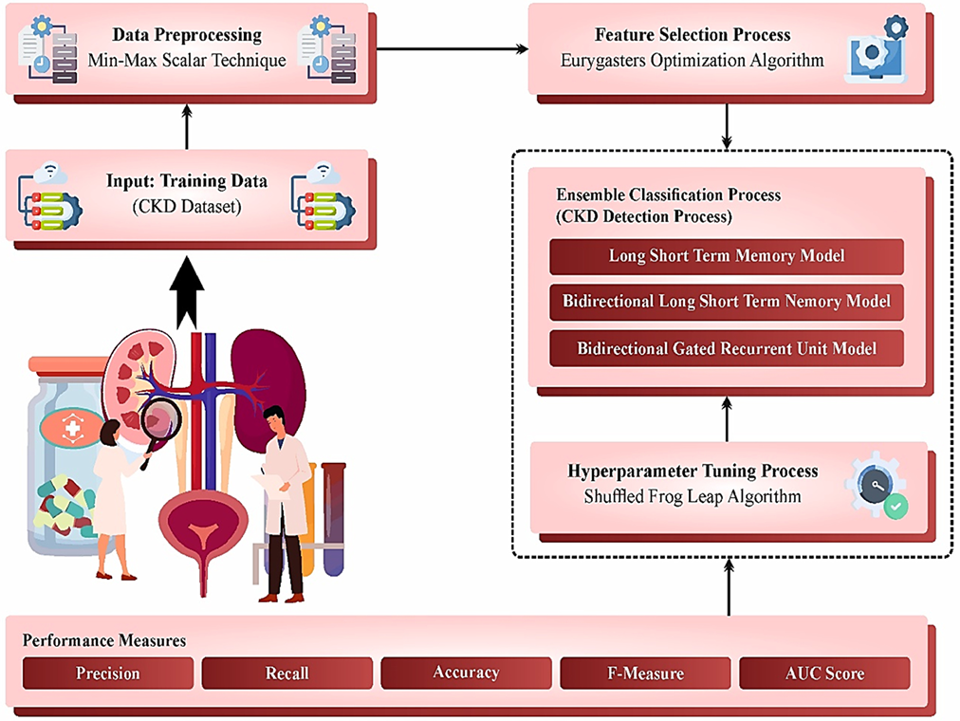
BLOCK DIAGRAM OR FLOW DIAGRAM

Slide 16
METHODOLOGY
Data Collection: Utilize publicly available clinical datasets containing patient records classified into CKD and non-CKD groups.
Data Preprocessing: Normalize the dataset using techniques like min-max scaling to ensure uniformity and enhance model performance.
Feature Selection: Apply optimization algorithms, such as the Eurygasters Optimization Algorithm, to identify and select informative clinical features for model training.
Model Development: Implement an ensemble of classifiers, including LSTM, BiLSTM, BiGRU, to improve classification accuracy.
Model Evaluution: Assess the model’s performance using metrics like precision, recall, and F1-score to ensure its effectiveness in early CKD detection.

Slide 17
IMPLEMENTATION
Dataset Preparation: Acquire and preprocess the clinical dataset, ensuring it is clean and normalized for analysis.
Feature Engineering: Utilize the Eurygasters Optimization Algorithm to select the most relevant features that contribute to CKD diagnosis.
Model Training: Train multiple machine learning models, including ensemble methods, using the prepared dataset to enhance predictive accuracy.
Hyperparameter Tuning: Optimize model parameters through techniques like cross-validation to performance and reduce overfitting.
Performance Evaluation: Validate the model using test data and evaluate its effectiveness with metrics such as precision, recall, and F1-score.

Slide 18
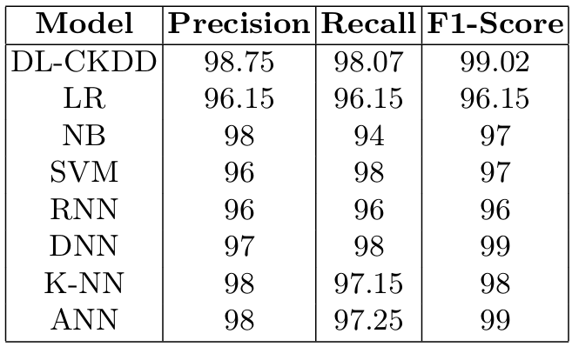
RESULTS & ANALYSIS
The DL-CKDD model achieved 98.75% accuracy, 98.75% precision, 98.07% recall, 99.02% F1-score, and an AUC of 98.83 for training, outperforming traditional models in CKD classification.

Slide 19
CONCLUSION AND FUTURE SCOPE
Conclusion: The DL-CKDD model effective enhances the detection of chronic kidney disease (CKD) by utilizing advanced ensemble deep learning techniques, achieving high accuracy and performance and significant potential for early diagnosis and can outperform existing techniques in sensitivity and specificity.
Future Scope: The algorithm can be optimized for real-time application in clinical settings and integrated into wearable devices for continuous health monitoring.
Future research can explore the application of this method to other chronic diseases, leveraging similar optimization and deep learning strategies.

Slide 20
REFERENCES
Sabanayagam Charumathi, Dejiang Xu, Daniel SW, Ting, Simon Nusinovici, Riswana Banu, Haslina Hamzah, Cynthia Lim, et al. "A deep learning algorithm to detect chronic kidney disease from retinal photographs in community-based popu lations." The Lancet Digital Health, vol. 2, no. 6, 2020, pp. e295-e302.
Sawhney, Rahul, Aabha Malik, Shilpi Sharma, and Vipul Narayan. "A comparative assessment of artificial intelligence models used for early prediction and evalua tion of chronic kidney disease." Decision Analytics Journal, vol. 6, 2023, p. 100169.
Hossain, Muhammad, Minoar Reshma Ahmed, Swarna Rafid Mostafiz, Pabon Shaha, Lubna Yasmin Pinky, Mohammad Motiur Rahman, Wahidur Rahman, Md Selim Hossain, Md Elias Hossain, and Md Sadiq Iqbal. "Analysis of the perfor mance of feature optimization techniques for the diagnosis of machine learning based chronic kidney disease." Machine Learning with Applications, vol. 9, 2022, p. 100330.

Slide 21
REFERENCES
Patro, Kiran Kumar, Jaya Prakash Allam, Bala Chakravarthy Neelapu, Ryszard Tadeusiewicz, U. Rajendra Acharya, Mohamed Hammad, Ozal Yildirim, and Paweł Pławiak. "Application of Kronecker convolutions in deep learning technique for au tomated detection of kidney stones with coronal CT images." Information Sciences, vol. 640, 2023, p. 119005.
Dey, Samrat Kumar, Khandaker Mohammad Mohi Uddin, Hafiz Md Hasan Babu, Md Mahbubur Rahman, Arpita Howlader, and KM Aslam Uddin. "Chi2-MI: A hybrid feature selection based machine learning approach in the diagnosis of chronic kidney disease." Intelligent Systems with Applications, vol. 16, 2022, p. 200144.
Vineetha, K. R., M. S. Maharajan, K. Bhagyashree, and N. Sivakumar. "Clas sifica tion of adaptive back propagation neural network along with fuzzy logic in chronic kidney disease." e-Prime-Advances in Electrical Engineering Electronics and Energy, vol. 7, 2024, p. 100463.

Slide 22
REFERENCES
Yousif, Sulima M., Awad, Hanan T. Halawani, Ghada Amoudi, Fathea M. Osman, Birkea Arwa, MR Almunajam, and Azhari A. Elhag. "Early detection of chronic kidney disease using eurygasters optimization algorithm with ensemble deep learning approach." Alexandria Engineering Journal, vol. 100, 2024, pp. 220-231.
Dashtban, Ashkan, Mehrdad A. Mizani, Laura Pasea, Spiros Denaxas, Richard Cor bett, Jil B. Mamza, He Gao, Tamsin Morris, Harry Hemingway, and Amitava Baner jee. "Identifying subtypes of chronic kidney disease with machine learning: devel opment internal validation and prognostic validation using linked electronic health records in 350067 individuals." EBioMedicine, vol. 89, 2023.
Halder, Rajib Kumar, Mohammed Nasir Uddin, Md Ashraf Uddin, Sunil Aryal, Sajeeb Saha, Rakib Hossen, Sabbir Ahmed, Mohammad Abu Tareq Rony, and Mosammat Farida Akter. "ML-CKDP: Machine learning-based chronic kidney dis ease prediction with a smart web application." Journal of Pathology Informat ics, vol. 15, 2024, p. 100371.

Slide 23
REFERENCES
Dharmarathne, Gangani Madhusha, Bogahawaththa Marion McAfee, Upaka Rath nayake, and D. P. P. Meddage. "On the diagnosis of chronic kidney disease using a machine learning-based interface with explainable artificial intelligence." Intelligent Systems with Applications, 2024, p. 200397.
Dataset: https://archive.ics.uci.edu/dataset/336/chronic+kidney+disease

Slide 24
QUESTIONS and ANSWERS
Any Queries…..?

Slide 25

ACKNOWLEGEMENTS
Contact:
Em Email: baravind350@gmail.com
vineethsvt@gmail.com
repudivivek5@gmail.com
Mobile No: 7671023946
9121358359
8341146317

